Slide 1

BUZZWORD
COMPLIANCE

Slide 2
Notes
Charles Merriam
Cell: 408.368.6050
Email: charles.merriam@gmail.com
Blog: http://charlesmerriam.com/blog
Copy of this talk: http://charlesmerriam.com/talk
Yes, you can have this talk given to your group. Email me.

Slide 3

Buzzword Compliance
3 Slides Per Buzzword
High Signal To Noise
Breadth Over Depth
About EXPLORING Python

Slide 4

Buzzword Compliance
The
Python
Language
Library Building Blocks
(Games & Graphics)
Big Honking Frameworks
(Web Application Frameworks)
All are part of Python

Slide 5
Notes
This talk rapidly covers a lot of buzzwords. For each buzzword covered, many are not covered.
I hope to provide useful information in the time allocated. That is, “a high signal to noise ratio.”
I hope to provide some map for how to explore Python, leaving the additional details to your exploration.

Slide 6
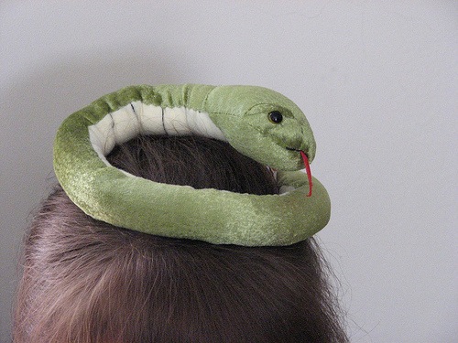
LEARNING
PYTHON

Slide 7
Learning Python
The Quick Reference Sheet
Python Tutorial
Python Challenge
A Cycle of Learning

Slide 8
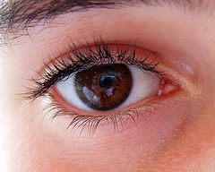
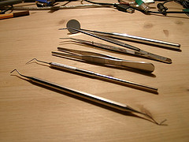
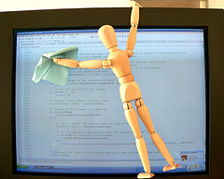
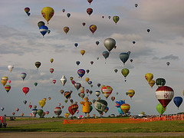
Learning Python
GENERAL READING
USE NEW TOOLS
CODE!
EXPLORE LIBRARIES

Slide 9
Links
Yes, this slide has the most links, 10 pages!
Richard Gruet's Python Quick Reference Sheet
    http://rgruet.free.fr/PQR25/PQR2.5.html
  Great reference guide to the language and syntax
  Online version includes direct links to most of the documentation
  Read once, and then keep a link to it open

Slide 10
Links
Bruce Eckel's Why I Love Python Presentation
    http://www.mindview.net/Books/Python/ThinkingInPython.html
  A powerpoint of why he loves Python
  Compares philosophy with other languages
  Mostly using cartoons

Slide 11
Links
Python Tutorial
    http://docs.python.org/tut/
  Guido van Rossum's basic tutorial
  Walks through syntax of Python using code examples and text.
  Covers the language and a brief tour of the standard library.

Slide 12
Links
Code Like a Pythonista
    http://python.net/~goodger/projects/pycon/2007/idiomatic/handout.html
  Covers the Zen of Python, tricks, and idioms
  Many useful idioms in Python take some practice to get right.
  A useful guide for those coming to Python from another language.

Slide 13
Links
Dave Kuhlman's Python 201
    http://www.rexx.com/~dkuhlman/python_201/python_201.html
  A talk covering different patches, like this Buzzword Compliance talk, but different topics
  Looks at Regular Expressions, Testing, Embedding, Parsing and GUIs.
  Definitely worth a look.

Slide 14
Links
AwareTek Tutorials Page
    http://www.awaretek.com/tutorials.html
  Contains hundreds of tutorials categorized by subject matter
  Fast way to get more information on some particular topic
  Not everything is best or relevant, but everything is here

Slide 15
Links
Advanced Python (or Understanding Python)
    http://www.charlesmerriam.com/blog/?p=48
  Video explains how namespaces are built at runtime
  Goes into iterators, decorators, and metaclasses
  Covers both the advanced topics and underlying simplicity
  Write up has time-line by topic

Slide 16
Links
Python Challenge
    http://www.pythonchallenge.com/
  Puzzles for Python Programmers
  You write code to find the next level
  Becomes 'guess the buzzword' after six or seven levels.

Slide 17
Links
Python Debugger
    http://docs.python.org/lib/module-pdb.html
  A module in the standard library for debugging
  Your IDE may give you a better interface
PyChecker
    http://pychecker.sourceforge.net/
  A light, "lint" tool for Python
  Can find some common errors

Slide 18
Links
WingWare IDE
    http://wingware.com/
  A well recommended closed-source Python IDE
  There is a minimal free version
Plug-ins exist for GEdit, Emacs, Vi, Eclipse, and everything else
  Google is your friend.

Slide 19
Notes
The key aspect is to not neglect any one of these activities for too long.
Even when in the midst of a project, explore libraries and tools. It may save you time.

Slide 20
[ ]
LIST
COMPREHENSIONS

Slide 21
List Comprehensions
A Cool Idiom of Python
Enables Conciseness
Obviates map, filter, reduce
Unrolls into Simple Loops

Slide 22
List Comprehensions
lost = sum([c.billed - c.paid for c in customers if c.is_deadbeat()])
  l = [ ]
  for c in customers:
  if c.is_deadbeat():
  l.append(c.billed - c.paid)
  lost = sum(l)

Slide 23
Notes
  Nothing magical, this is just a shorter way of writing common idioms we all have written a million times.
  Python often uses the idea of “equivalent to longer code” to keep the language simple.
  After a week, you will never do without them.
Python Tutorial on List Comprehensions
  http://docs.python.org/tut/node7.html
  walks through a few examples in section 5.1.4

Slide 24
Notes
For extra fun points:
  list comprehensions use a list
  list comprehensions return a list
  so, list comprehensions can be nested.
  so, you too can make unreadable code

Slide 25

EXECUTING
MODULES

Slide 26
Executing Modules
Import runs code, once.
def is just a statement
Use to precalculate stuff
Python just runs scripts in namespaces

Slide 27
Executing Modules
class C:
print “Hello from C”
def help_make_table(size):
...
c_table = help_make_table(64)
del help_make_table

Slide 28
Notes
  The system remembers which classes and modules have been executed.
  .PYC files are simply tokenizers to speed loading. They don't pre-execute.
  The "def func():" statement places an entry func into the local namespace.
  The namespace is just a dictionary (dict).
  Function names are just variables like any other.

Slide 29
Links
Advanced Python (or Understanding Python) Video (again)
    http://video.google.com/videoplay?docid=7760178035196894549
  At 4:15, talks about Python's execution in namespaces.
  At 8:45, walks through an equivalent example of executing with a temporary method in a class.

Slide 30
@
DECORATORS

Slide 31
Decorators
Wraps methods with new functionality
Useful for logging, security, etc.
Clean Syntax for use
Unrolls to simple code

Slide 32
Decorators
from decorator import decorator
@decorator
def trace(f, *args, **kw):
print "call %s with args %s, %s" % (f.func_name, args, kw)
return f(*args, **kw)
@trace
def buggy_function(a, b, c)

Slide 33
notes
A decorator does something, then (usually) calls your function.
This is another Python 'equivalent code' trick:
  @trace
  def myFunc(): print “Hello”
is equivalent to:
  def myFunc(): print “Hello”
  myFunc = trace(myFunc())

Slide 34
notes
Best used when the function and the decorator are solving distinct problems.
Avoid the Java file types thing where decorators are confused with subclassing.
Boilerplate code for decorators is required unless you use @decorator.
Still need boilerplate to pass extra parameters to your decorator, e.g., @check_level(ADMIN)

Slide 35
links
Michelle Simionato's Decorator Decorator
    http://www.phyast.pitt.edu/~micheles/python/documentation.html
  Provides good @decorator syntax for writing decorators
  Correctly identifies name and number of arguments of decorated function in IDEs and other tools.
  You will probably never write a decorator without this package again.

Slide 36
links
David Mertz's Decorator Tutorial
    http://www-128.ibm.com/developerworks/linux/library/l-cpdecor.html?ca=drs-#resources
  A good walk through of Decorators, their uses, and their pitfalls
  Introduces Michelle Simionato's Decorator Decorator

Slide 37


Slide 38
commentary
This moon introduces the “dark side” of Python. These are areas, in my own opinion, where the Python languages gains opportunities for significant improvement. The characterization of these areas as “dark side” is an opinion, and you may form different opinions.

Slide 39
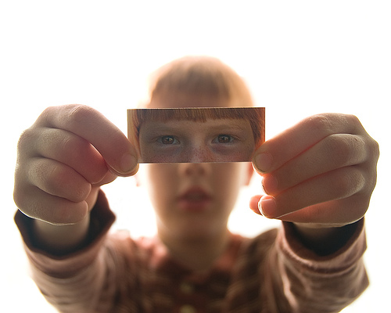
METACLASSES

Slide 40
Metaclasses
The superclass 'type' of classes
Changes functionality of Python
Adds complexity to entire project
Shiny things can be traps

Slide 41
Metaclasses
class Midnight_Hack(type):
def __new__(cls, name, bases, ats):
for a,v in ats.items():
# post-process ats...
return type.__new__(cls, name, bases,ats)
class Innocent_PEP_3115(P3000):
__metaclass__ = Midnight_Hack

Slide 42
Notes
Mechanically, the 'type' object is a metaclass. You can write your own metaclass to get handle class creation and instantiation. You then specify a class use a particular metaclass.
You can add in new name swizzling, make Aspect oriented programming
Changes Python. Code readers and some tools are no longer sure what a line of code does.

Slide 43
Notes
Using metaclasses adds to the complexity of your project, even though it shouldn't.
Should be a company level or project level decision.
Hang rogue programmers by toes if they insist on metaclasses for trivial reasons.

Slide 44
links
David Mertz's Metaclass Tutorial
    http://www.ibm.com/developerworks/linux/library/l-pymeta.html
    http://www.ibm.com/developerworks/linux/library/l-pymeta2/
    http://www.ibm.com/developerworks/linux/library/l-pymeta3.html
  A long overview of metaclasses, more than you might want to know.
Very few uses for metaclasses

Slide 45
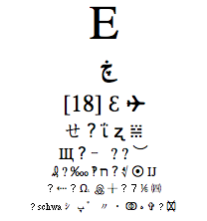
UNICODE

Slide 46
Unicode
Represents every human language
Breaks all ASCII rules
Designed by Committee
Real world adds constraints

Slide 47
Unicode
UNICODE Jargon includes: Universal Character Set; The Unicode Standard book; character encodings; enumerate properties; text normalization; decomposition;
collation; bidirectional display order; Unicode Consortium; Ligatures; orthographic rules; sidebearing; macron; WGL-4; Multilingual European Subsets MES-1/2/3a/3b;
replacement character; LastResort font; UTF-8; codec.open(); ISO 14755;
C0 and C1 control codes; Han unification versus TRON; GB-18030;
Binary Ordered Compression; Basic Multilingual Plane; UnicodeDecoderError on
str.encode() contrasted with UnicodeEncoderError on str.decode(); endianness
external metada ta; PunyCode; graphemes; syllabaries; ConScript Unicode Registry;
Universal Transformation Format versus Universal Character Set mappings; Private
Use Area; Hangul Jamo; radicals
Just “make peace” with Unicode

Slide 48
Notes
All languages:
  Everything is represented. Umlat's, glyphs, weird directions, different widths. English, French, (Hebrew's right to left with a different alphabet). Sanscrit. Klingon. Elvish.
  Representation as sequence of bytes is a separate encoding issue. Many use UTF-8, which takes one byte for Latin languages and many for Asian languages. Encoding is out of band of text.

Slide 49
Notes
Old programmers must grok Unicode:
  Used to plan on uniform character widths, heights, and direction for layout.
  Used to have a unique character for output and be able to glance at screen to determine which character was output.
  Used to ranges encompassing groups, like all lowercase characters being contiguous.
  String comparisons must be more careful.

Slide 50
Notes
Unicode Standards Committees
    http://unicode.org/
  High paying members alter standards for corporate strategies and tactics.
  Official and unofficial sources and variants.
  Official sources cost money.
  Scheduled face-to-face meetings and conference calls instead of implementation or chat driven.
  Very unlike open source standards. It's a career!

Slide 51
Warnings
Unicode support in Python, and in Python 3.0, is about the best you will find, including codecs classes. Unicode will still be a problem.
Expect programs to become less reliable as odd Unicode mangles display layouts.
Unicode support != Localization. You will still use gettext().
Add some test cases with odd language inputs.

Slide 52
Links
Wikipedia
    http://en.wikipedia.org/wiki/Unicode
  Some general Unicode information
  Note that even the 'talk' page has 70 entries
  Primary Wikipedia unicode article is in Russian.
Oddly, no English language videos explaining Unicode are available on YouTube (as of today).

Slide 53
Links
Advanced Python (or Understanding Python) Video (again)
    http://video.google.com/videoplay?docid=7760178035196894549
  At 1:04:32, it discusses Python 2.x unicode for ten minutes.
  Recommends not to mix Ascii and Unicode.

Slide 54
Notes
Python 3.0 uses Unicode strings
  All “strings” become unicode strings.
  ByteArray replaces the current strings
  “Hello” is unicode, b”Hello” is five ASCII bytes.
  They do not mix implicitly. This is good.

Slide 55
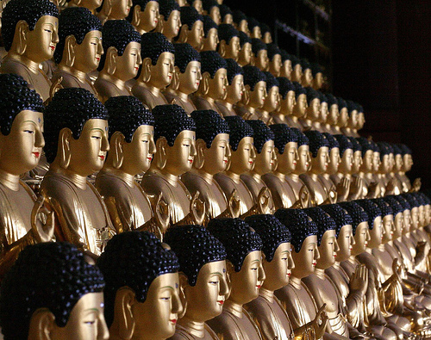
PYTHON
3000

Slide 56
Python 3000
Incremental not Revolutionary
Need to read old code
Available as Alpha (3.02a)
Guido exercises restraint

Slide 57
Python 3000
Function Annotations PEP-3107
def create_map(x: “in map units”,
y: “in map units”,
walls: “2D boolean array (x by y) with True meaning a wall”,
pixel_width: “number of pixels per map unit”) -> “Graphical PNG map”
def random_map(x: Coord, y: Coord) -> Image:

Slide 58
notes
Notice that many features will be of controversial value.
  Some, like PEP 3107, will allow code bases to implement very different and incompatible styles.
  Some, like PEP 3129, were added with little discussion.
  Unclear that Python 3.0 code will be more elegant than Python 2.5.

Slide 59
notes
Code must be reread and retested
  Changes, like the printing of long numbers as strings losing the trailing 'L', will require review of all code to avoid subtle bugs.
2to3 tool aids conversion, handling mechanical changes
Download Latest Version (3.02a today)
    http://www.python.org/download/releases/3.0/
  It's starting to gel and solidify. Expect 2008.

Slide 60
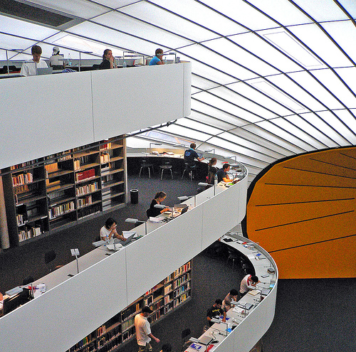
Libraries

Slide 61
notes
One can explore any set of libraries, I'm using imaging libraries as an example.
See Python 3D Software Collection
    http://www.vrplumber.com/py3d.py
  A list of various 3D packages and games in Python
  Good starting place with too few reviews
  Note how wildly libraries vary in quality

Slide 62

Python Imaging Library
(PIL)

Slide 63
Python Imaging Library (PIL)
Reads and Writes Image Formats
Rock solid with 250 formats
Interactive image manipulation
Not all 'batteries included'.

Slide 64
Python Imaging Library
import Image
im = Image.open(“cool.jpg”)
im = im.resize(128,128).rotate(90)
im.save(“cool.png”)
(r,g,b) = im.split()
(x,y) = im.size
im.show()

Slide 65
Notes
The PIL by Pythonware
    http://www.pythonware.com/products/pil/
  Tutorial should be sufficient documentation for most users. It's about a page or so.
  The handbook is the complete documentation.
  Free is the same version as commercial support
  Last updated in December 2006, releases about once per year.

Slide 66


Slide 67
PyGame
Easy 2D Game Engine
Aggressively cross platform
Continuous contests
Sometimes static != static

Slide 68
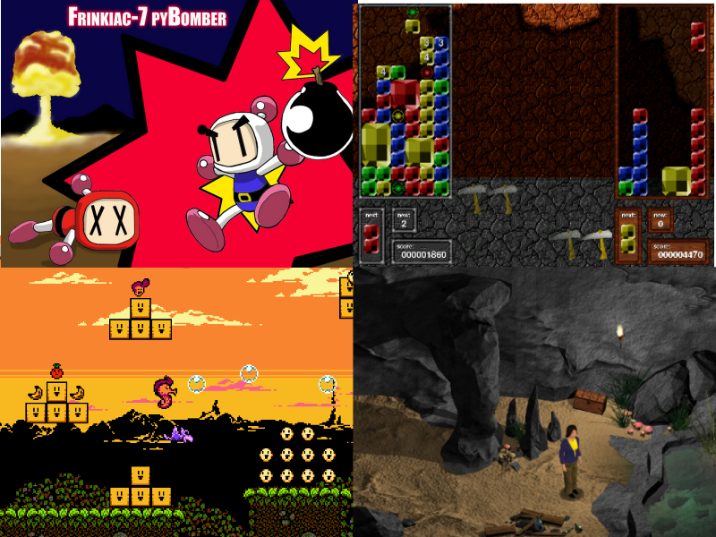

Slide 69
Notes
Complete but small 2D game engine with drawing, sounds, joysticks, sprites, etc.
  Works on all sorts of smaller devices.
Last release was August, 2005
  Various forks for devices, odd integrations, etc.
  Huge fan base.
  Very stable core

Slide 70
Links
PyGame
    http://www.pygame.org
  This has samples, tutorials, and all documentation
"Beginning Game Development with Python and Pygame: From Novice to Professional", 2007
    http://www.amazon.com/gp/product/1590598725

Slide 71


Slide 72
Soya 3D
Full 3D Game Engine (almost)
Uses Pyrex for linking modules
Slow and forked with PySoy
Avoid Python centric bias

Slide 73
Notes
The main Soya site:
    http://home.gna.org/oomadness/en/soya3d/index.html
The main PySoy (spin-off) sites:
    http://www.pysoy.org
    http://www.soya3d.org/
  FAQ recommends against PySoy use yet
Only about a dozen games using either fork

Slide 74
Notes
Includes graphics, sound, physics, and networking
Pyrex is a Python variant with C Datatypes
    www.cosc.canterbury.ac.nz/greg.ewing/python/Pyrex
Soya is assembled on several libraries from different sources.

Slide 75


Slide 76
Python OGRE
Game Engine From Wrappings
Uses Py++ to make Python bindings
OGRE is popular
Sometimes a “Mash-up” is best

Slide 77
Python OGRE
Rendering (OGRE 3d + Forests/sky/terrain)
I/O (Object Oriented Input System or OIS)
GUI (Crazy Eddie GUI & Navi & BetaGUI)
Sound (OgreAL & Plib + Noise)
Physics (NxOgre / PhysX, OgreODE / ODE, OgreNewt / Newton, OgreBullet / Bullet)
Networking (Plib)
Video (Theora, OgreDshow, ffmpeg)

Slide 78
Notes
Python Ogre was originally named PyOgre
  PyOGRE just wrapped OGRE.
  To find good answers, you may need to check three forums: Python-OGRE, PyOgre, and OGRE.
OGRE Handles scenes, lighting, object placement. Not game mechanics.
OGRE spawned many separate projects for game mechanics.

Slide 79
Notes
OGRE is basis for several commercial games
Py++ is another wrapping engine for C++ Code
      http://www.language-binding.net/pyplusplus/pyplusplus.html
  Py++ wrapping is an automatic process.
  Handles API changes quickly.

Slide 80
Links
Python Ogre site
    http://python-ogre.org/
The main OGRE site.
    http://www.ogre3d.org/
The Two Wikis
    http://wiki.python-ogre.org/index.php/Main_Page
    http://www.ogre3d.org/wiki/index.php/PyOgre

Slide 81
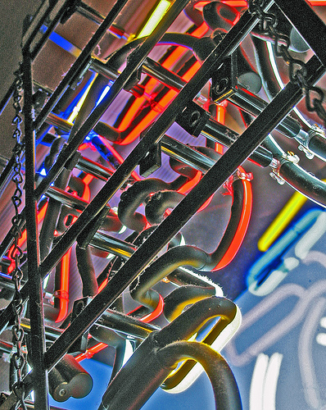
Frameworks

Slide 82
notes
Frameworks are what libraries morph into when they grow huge.
Frameworks generally want control. You call a framework and it calls your code. Libraries want you to call them
Using multiple libraries in an application is easy while using multiple frameworks is significantly harder.

Slide 83
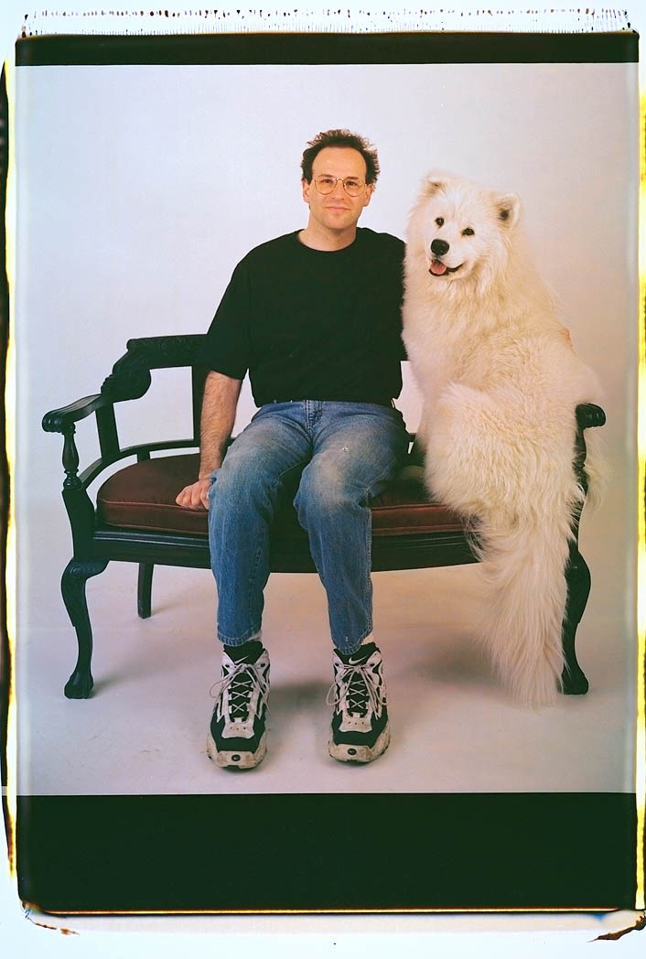
Web Application Frameworks

Slide 84
Piece of History. Picture is cover of:
  Phil and Alex's Guide to Web Publishing
    http://philip.greenspun.com/panda/
    http://www.amazon.com/Philip-Alexs-Guide-Web-Publishing/dp/1558605347
  Phil Greenspun wrote this coffee table book full of photos, which also showed how to build a solid database backed web site using TCL and Oracle.

Slide 85
Web Application Servers
Deploy Web Applications
Pile of Parts
Dozens of Choices
Indecision Breeds Religious Arguments

Slide 86
ADMIN
INTERFACE
CACHE
WEB
SERVER
URL REWRITE
SECURITY
PYTHON
TESTING
TEMPLATE
ENGINE
AJAX
MIGRATION
OBJECT/RELATIONAL MAPPING
USER
IDENTITY
DATABASE

Slide 87
notes
That's a lot of components!
  Each component represents its own field.
  Total number of lines of code is immense
Wikipedia is your friend for overviews
    http://en.wikipedia.org/wiki/Web_application_framework
    http://en.wikipedia.org/wiki/Comparison_of_web_application_frameworks

Slide 88
notes
Note that language has shifted over time.
  In the 1980's, these were called "Database Backed Websites"
  In the 1990's, these were called "Application Servers", then "Web Application Servers"
  In the 2000's, these are called "Web Application Frameworks"
Still same basic issues, with better parts.

Slide 89
reviews
Comparison by James Cooley
    http://james.cooley.ie/2007/03/05/django_turbogears_rails_and_the_feature_curve.html
  Written back in March, 2007
  Short comparison of frameworks, along with Ruby on Rails
  Basically recommends Django when you control the environment and either TurboGears or Pylons when you are integrating existing components.

Slide 90
reviews
Neil Blakely-Milner's comparison
    http://tinyurl.com/2v4p2a
  Another comparison Written in June, 2007
  Recommends Django for smaller projects

Slide 91


Slide 92
Zope
Scalable Since 1995
Full web based interface
Zope 2 and Zope 3
Success is its own reward

Slide 93
ADMIN
INTERFACE
CACHE
WEB
SERVER
URL REWRITE
SECURITY
PYTHON
TESTING
TEMPLATE
ENGINE
AJAX
MIGRATION
OBJECT/RELATIONAL MAPPING
USER
IDENTITY
DATABASE

Slide 94
ADMIN
INTERFACE
CACHE
WEB
SERVER
URL REWRITE
SECURITY
PYTHON
TESTING
TEMPLATE
ENGINE
AJAX
MIGRATION
OBJECT/RELATIONAL MAPPING
USER
IDENTITY
DATABASE

Slide 95
notes
See also:
    http://en.wikipedia.org/wiki/Zope
    http://www.zope.org/
    http://www.zopelabs.com/
    http://wiki.zope.org/WikiZopeOrg
  Note the major disparate sets of Zope 2 and Zope 3 pages
Many Zope Books published, all over two years ago.

Slide 96


Slide 97
Django
Emphasis on Don't Repeat Yourself (DRY)
Interactive console
Unfortunate naming, e.g., MVC
Confusion Comes From Names

Slide 98
ADMIN
INTERFACE
CACHE
WEB
SERVER
URL REWRITE
SECURITY
PYTHON
TESTING
TEMPLATE
ENGINE
AJAX
MIGRATION
OBJECT/RELATIONAL MAPPING
USER
IDENTITY
DATABASE

Slide 99

APACHE,
MOD_PYTHON,
ETC.
ADMIN
INTERFACE
CACHE
WEB
SERVER
URL REWRITE
SECURITY
PYTHON
TESTING
TEMPLATE
ENGINE
AJAX
MIGRATION
OBJECT/RELATIONAL MAPPING
USER
IDENTITY
DATABASE

Slide 100
Notes
Naming
  MVC language in Django is "Model-Template-View"
  The 'D' is silent in Django
  Most top Google hits will be to a musician
Informal extra reviews
  Great, fast development if you stay within the lines
  Extending Django feels like “struggling in straightjacket”

Slide 101
links
Wikipedia Overview
    http://en.wikipedia.org/wiki/Django_(web_framework)
Main Django Site
    http://www.djangoproject.com/

Slide 102
books
    "The Definitive Guide to Django: Web Development Done Right", December 2007
      http://www.amazon.com/Definitive-Guide-Django-Development-Right/dp/1590597257/
    "Professional Python Frameworks: Web 2.0 Programming with Django and Turbogears (Programmer to Programmer)", 2007
      http://www.amazon.com/Professional-Python-Frameworks-Programming-Turbogears/dp/0470138092
    “Sams Teach Yourself Django in 24 Hours", expected March 2008
      http://www.amazon.com/Sams-Teach-Yourself-Django-Hours/dp/067232959X

Slide 103


Slide 104
TurboGears
Assembled from more parts
More screencasts
Still fairly young
Outreach Makes People Happy

Slide 105


ADMIN
INTERFACE
CACHE
WEB
SERVER
URL REWRITE
SECURITY
PYTHON
TESTING
TEMPLATE
ENGINE
AJAX
KID
MIGRATION
OBJECT/RELATIONAL MAPPING
SQLObject
USER
IDENTITY
DATABASE

Slide 106
notes
TurboGears is rumored to be being reimplented using Pylons as a foundation.
Wikipedia Overview
  http://en.wikipedia.org/wiki/TurboGears
Main Site
  http://turbogears.org/

Slide 107
books
  "Rapid Web Applications with TurboGears: Using Python to Create Ajax-Powered Sites", November 2006
    http://www.amazon.com/Rapid-Web-Applications-TurboGears-Ajax-Powered/dp/0132433885
  "Professional Python Frameworks: Web 2.0 Programming with Django and Turbogears (Programmer to Programmer)", 2007
    http://www.amazon.com/Professional-Python-Frameworks-Programming-Turbogears/dp/0470138092

Slide 108
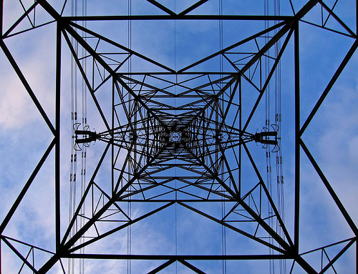
Pylons

Slide 109
Pylons
Reimplements Ruby on Rails
Lots of Code Generators
Flexibly Assembled with Python Paste
Flexibility has its limits

Slide 110
notes
So flexible, I can't even tell you what modules are used or included.
Really a paste for assembling custom web application servers.
Many audience members suggest I'm unfairly harsh about its maturity.

Slide 111
links
Wikipedia Overview
    http://en.wikipedia.org/wiki/Pylons
Main Site
    http://pylonshq.com/
Walk-through of building first Pylons site
    http://www.rexx.com/~dkuhlman/pylons_quick_site.html

Slide 112
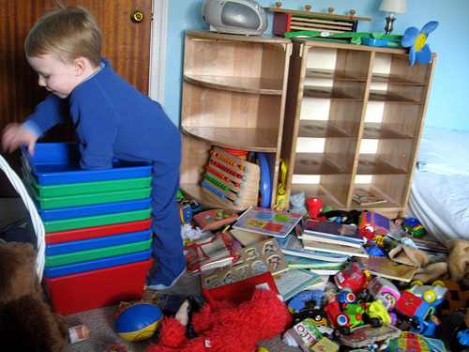
Content
Management
Systems

Slide 113
Content Management Systems
Web Site Publishing
On top of Web Application Servers
One Serious Choice
Great When It Just Works!

Slide 114
notes
Extends application server to include workflow, more user management, versioning, and testing sample audiences.
Used for those who need to keep a web site running with fresh content.
Some web frameworks try to add “CMS” modules.

Slide 115


Slide 116
Plone
Built on Zope
Strong Support Base
Archetypes and Extendable Content Types
Right Design Helps a Lot

Slide 117
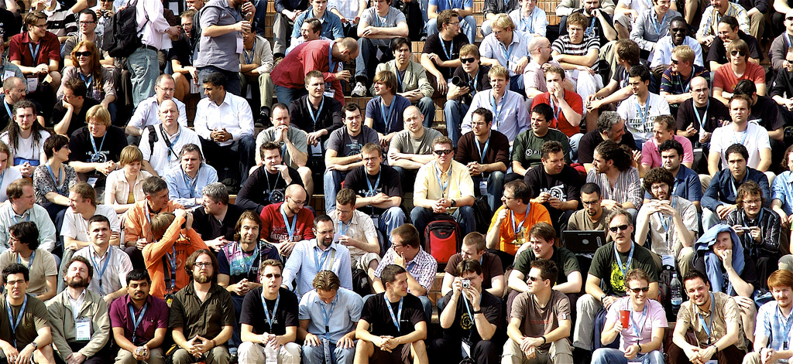
Plone

Slide 118
notes
  Wikipedia Overview
    http://en.wikipedia.org/wiki/Plone_(content_management_system)
  Main Site
    http://plone.org/
  The Plone Network advocacy/referral site
    http://plone.net/
  San Francisco Plone Users Group (Plone Lounge)
    http://www.plonelounge.com/

Slide 119
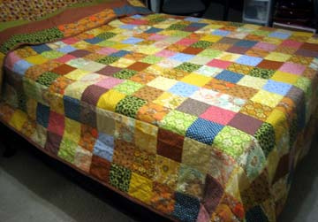
Finished!

Slide 120
Summary
Keep Exploring Python
Wikipedia is Your Friend
Ignore Version Numbers
Learn until you are dead and buried.

Slide 121
notes
This talk covered some of the squares of the large quilt that is Python.
The “Cheese Shop” global Python modules list
  http://pypi.python.org
The CheeseRater module ratings
  http://www.cheeserater.com

Slide 122
Summary
Charles Merriam
Phone: 408.368.6050
Email: charles.merriam@gmail.com
Blog: charlesmerriam.com/blog
Slides and Notes: charlesmerriam.com/talk

Slide 123
Photo credits
Snakes on my head by O Pish Post
http://flickr.com/photos/opishposh/221395779/
Running Away by Ozyman
http://flickr.com/photos/ozyman/148793655/
Meta Mini Moo by Darkmatter
http://flickr.com/photos/cdm/1410539606/
Jagwangsa 3000 Buddha by Bebouchard
http://flickr.com/photos/bebouchard/404576063/
Unicode Eyechart in Firefox 2 by sillygwalio
http://flickr.com/photos/sillygwailo/543388337/
Vitamin E Redux by Selva
http://flickr.com/photos/selva/7737130/
Carry on up the Pylon by Arkadyevna
http://flickr.com/photos/arkadyevna/246047088/
Trains and Messes by Martin Kelley
http://flickr.com/photos/martin_kelley/408474778/
My Eye by OrangeAcid
http://flickr.com/photos/orangeacid/234358923/
Code Washing by Ezu
http://flickr.com/photos/ezu/277341190/
My New Mupal Tools by animaux
http://flickr.com/photos/animaux/103725084/
A "Few" Balloons by Mortimer
http://flickr.com/photos/mortimer/127194972/
Finished Quilt by Annette Pedrosian
http://flickr.com/photos/annettepedrosian/437261669/
Library by Swenwerk
http://flickr.com/photos/svenwerk/248594239/
behind... by Thomas23
http://flickr.com/photos/livenow/185186715/
Phil & Alex by Phil Greenspun
Lots of Plone Folk by MrTopF
http://flickr.com/photos/mrtopf/1543890810/
Dark Side of the Moon by Callumalden
http://flickr.com/photos/callumalden/48953166/

